Slide 1
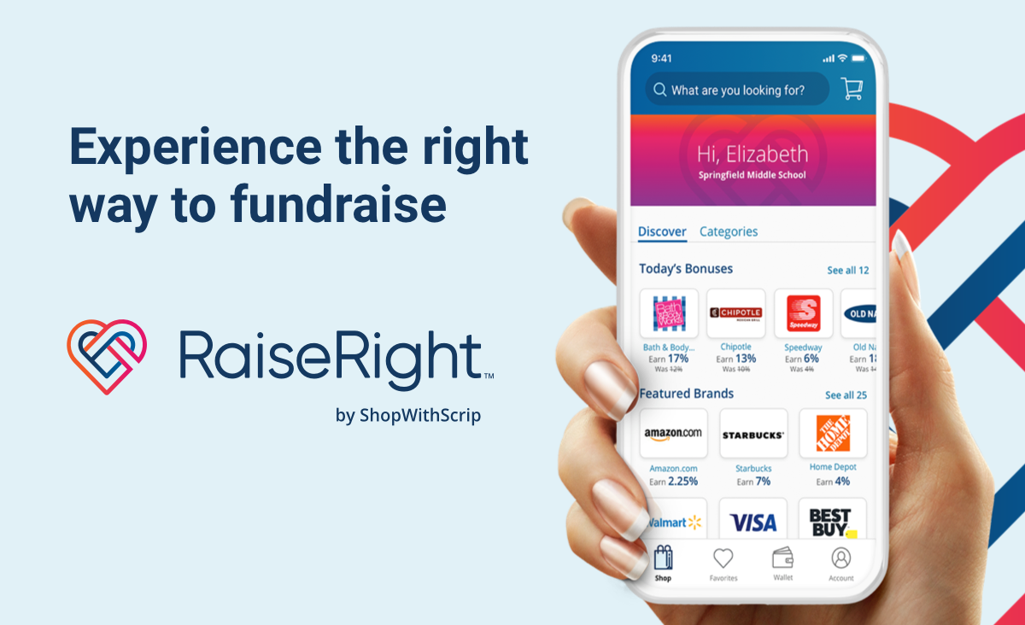
What is Raise Right? (Formerly known as Scrip)
Raise Right is fundraising while you shop. Raise Right turns everyday shopping into cash for your student and our band program when you use gift cards, instead of credit, cash or checks, to pay for everyday purchases such as groceries, gas, movies or food at a restaurant.

Slide 2
Earn money by shopping at your favorite retailers and earning rebates from 1% to up to 18%.

Slide 3
What Raise Right Really is…
Free Money!!

Slide 4
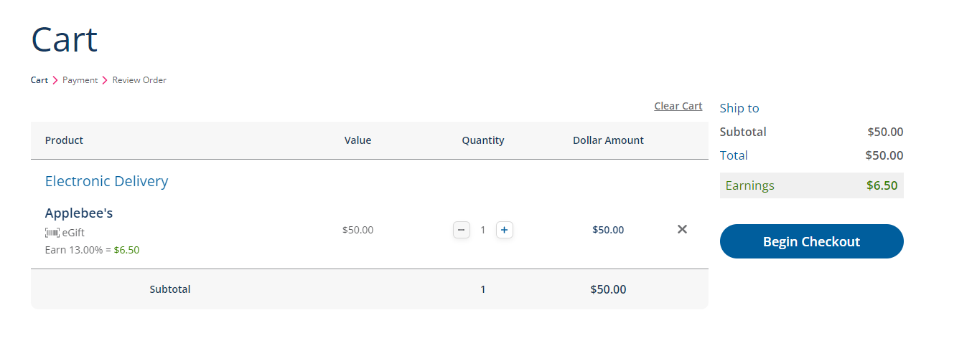
Why is Raise Right Better?
Earnings add up fast just for buying things you would buy anyway.
Everyday family purchases become earnings for our band.
75% of the percentage earnings from the gift cards you purchase, go towards your student’s account in the form of credits.
Reduce credit/debit card fraud risk by using gift cards for purchases.
Rewards are usually higher than credit card rewards.
If I was purchasing a $50 Applebee’s eGift card, as you can see it say Earnings of 13%. 13% of $50 is $6.50 net earnings from this eGift card.
This is a 75/25 Split Fundraiser:
75% of $6.50 will go into my student’s account - $4.88 in credits
25% of $6.50 will go to MCBB - $1.63
Remember all cards have different earning % and we collect the reports monthly then review and apply to accounts.

Slide 5
How Much Can You Earn with Raise Right?
Item | Monthly Budget | Monthly Rebate | Annual Rebate Per Family (x10m) | Annual Rebate 15 Families (10m) | Annual Rebate x100 Families
Groceries | $400 (5%) | $20.00 | $200.00 | $3,000.00 | $20,000.00
Dining Out | $50 (10%) | $5.00 | $50.00 | $750.00 | $5,000.00
Entertainment | $30 (6%) | $1.80 | $18.00 | $270.00 | $1,800.00
Gasoline | $200 (1.5%) | $3.00 | $30.00 | $450.00 | $3,000.00
Clothing | $50 (8%) | $4.00 | $40.00 | $600.00 | $4,000.00
Home Maint. | $100 (4%) | $4.00 | $40.00 | $600.00 | $4,000.00
Pet Supplies | $40 (5%) | $2.00 | $20.00 | $300.00 | $2,000.00
TOTALS |  | $39.80 (75% = $29.85) | $398.00 (75% = 298.50) | $5,970.00 (75% = $4,477.50) | $39,800.00* (75% = $29,850.00)
*The band’s 25% would be $9,950.00.

Slide 6
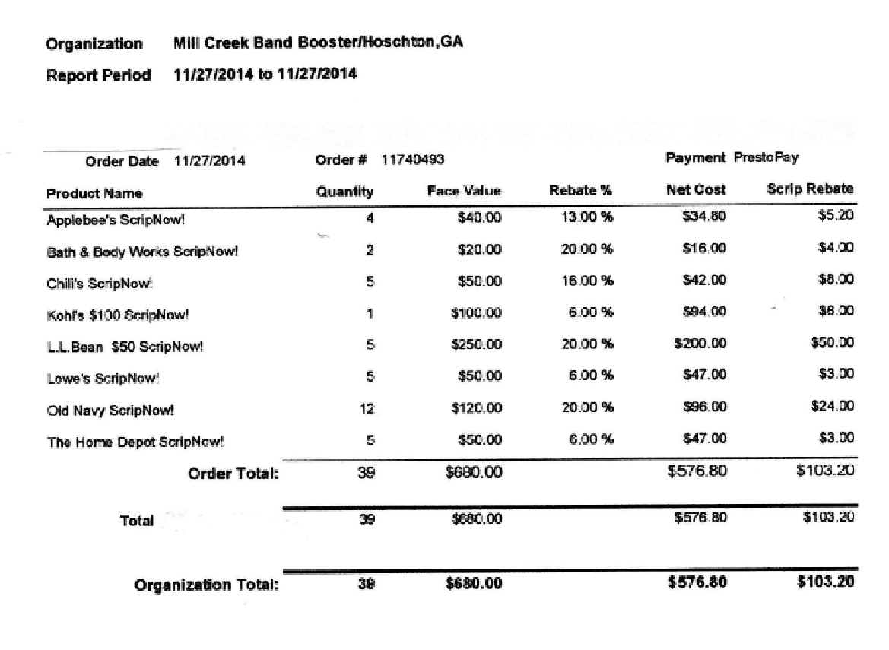
Thank-scrip-ing Day: receive special discounts.
**Band account earns $77.40.

Slide 7
Some Top Rebate Earners Since 7/12/21
 | Rebates Earned on Online Orders | Rebates Earned on Cash & Carry Orders | Total Rebates Earned | Band Account (75% of Rebates)
Family A | $305.10 | $37.50 | $342.60 | $256.95
Family B | $814.45 | $0 | $814.45 | $610.84
Family C | $524.77 | $90.00 | $614.77 | $461.08
Family D | $367.75 | $0 | $367.75 | $275.81
Family E | $610.50 | $66.00 | $676.50 | $507.37
Family F | $508.65 | $14.00 | $522.65 | $391.98

Slide 8
How Do I Sign Up?
Go to www.raiseright.com Click on the SIGN UP button. On the next screen find the JOIN AN EXISTING PROGRAM box and put in the Mill Creek Band Booster enrollment code, 48E9C97B17985. The number is also available on the POMC site, under the “More” tab, then click MCBB, then fundraising.
Be sure to add your student’s name to your Raise Right account so they may be given credit.
If you are having trouble, click on the ACCOUNT icon on the top right,
then SUPPORT, then PARTICIPANT RESOURCE CENTER. Here you will find videos and instructions to help you.
Be sure to add a bank account to your Raise Right account. It is the best way to get eCards delivered instantly to your phone or computer.
You can pay with a credit card but some fees apply.
You can pay by check but we must have your check in hand before your order will be released and you can access it.

Slide 9
When your account is established, you can:
Download the Raise Right App for your smartphone from the Apple App Store or from the Google Play store. Log in to your account and start shopping. You can buy some eCards right in the check out line or at the table in a restaurant.
Order eCards that are delivered to your wallet for printing or to your smart phone for scanning. (Not all cards are available as eCards. You must look on the page for the card.)
Go Green and reload your favorite plastic card purchased from Raise Right. (Not all cards available for reload.)
For a small fee, you can order plastic cards that are available for “ship to home” and have the card shipped directly to you. If this option is not available on the plastic card you want, you must wait until the Scrip Committee sends out an email indicating that we will be placing a plastic card order. Any orders for plastic placed outside of this window will have to be cancelled. We hope to be able to order plastic 1x per month. Cards can be picked up from the Scrip Coordinator or from the Scrip Table at the school. The schedule will be emailed to you soon.
For more information you can contact a member of the Emily Jimenez, Scrip Committee, at mcbbraiseright@gmail.com.

